Slide 1
Real Estate (File structure mini project)

Slide 2



OBJECTIVE
1
To build a unique collaborative platform
2
Acknowledge
3
Reduce the latency and work load while searching an apartment

Slide 3


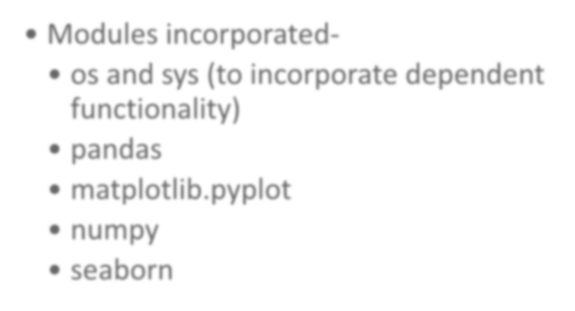
Languages and packages used while implementing the platform .
Language used- Python (Version 3.x/2.7)
Modules incorporated-
os and sys (to incorporate dependent functionality)
pandas
matplotlib.pyplot
numpy
seaborn

Slide 4





REQUIREMENT
Version Control (Git)
Text Editor - Atom/sublime
OS-
Linux/windows

Slide 5

How we managed to do our project remotely ?
We used Git. With this powerful tool, we managed our code, commits, could save our project from catastrophically silly mistakes!
GitHub is a Web-based Git version
control repository hosting service.
BOOM !!!
It’s open source ………….

Slide 6
Let’s dive into
demo

Slide 7

Start screen

Slide 8



FUNCTIONAL UTILITIES
1 2 3
4
5
1) Insertion - This functionality helps in inserting details which are related to the apartments/estates. These details include the
apartment’s name, size,
price, owner’s information, condition, etc. Each of the details are explicitly added which are stored in a file
2) Searching - This functionality helps the user in searching for an apartment according to the field entered. The search can be done according to different parameters entered by the user.
3) Modifying - This functionality helps in making changes to the added apartments. The user can change the apartment details such as name, price, condition, size, owner’s name, etc.
4) Deletion-Select a particular record and delete it.
5) Visualizing – This functionality help in visualizing the data based on different parameters. This is done in the form of graphical representations for better understanding.

Slide 9
METHOD USED : INDEXING
Why indexing ?
Data is usually stored in random order in hard disk . In order to search for a data , we will require to do sequential searching which takes a lot of time .
For sorting all the data , we need to put them all in the main memory . This is practically not possible as data in main memory will usually be way smaller than the amount of data in the hard disk . Therefore we use indexing .
By using indexing , we reduce the time complexity from O(n)
to log n .

Slide 10
What’s interesting in our portal ?
Data analytics and visualisation-
Data analytics and visualisation can create a huge impact in the business of real estate. The project has a miniature version of the same. We have implemented analytics with the raw data sets available on Kaggle and Gov.in.
Implementation-
Fire up the console and run the estate.py script

Slide 11
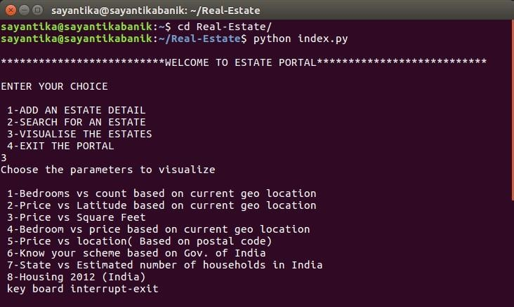
SELECT THE OPTION-

Slide 12
FUTURE ENHANCEMENT
Enhancing the portal to incorporate higher order algorithms (Hashing/ Dynamic Hashing)
Scaling the portal with GUI.
Storing the data sets directly into cloud providing centralized availability

Slide 13






Slide 14
THANK YOU

